Slide 1
Express your ideas - An Introduction to MATLAB
Jasmina Lazić, BSc, PhD
Application Engineering, MathWorks Inc.
MATLAB for Finance: From Research into Production
23rd April 2013

Slide 2

Agenda
Overview of the MATLAB Solution
Portfolio Analysis
Data import
Visualizing data
Customised portfolio analytics
Reporting
Backtesting a portfolio management strategy
Key Takeaways

Slide 3
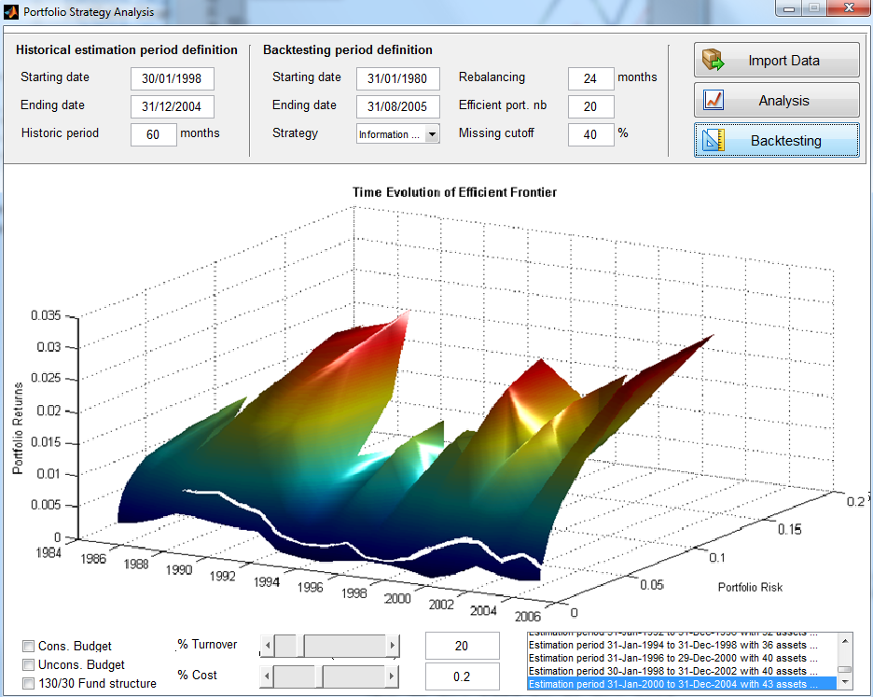
Demo : Backtesting a portfolio management strategy

Slide 4
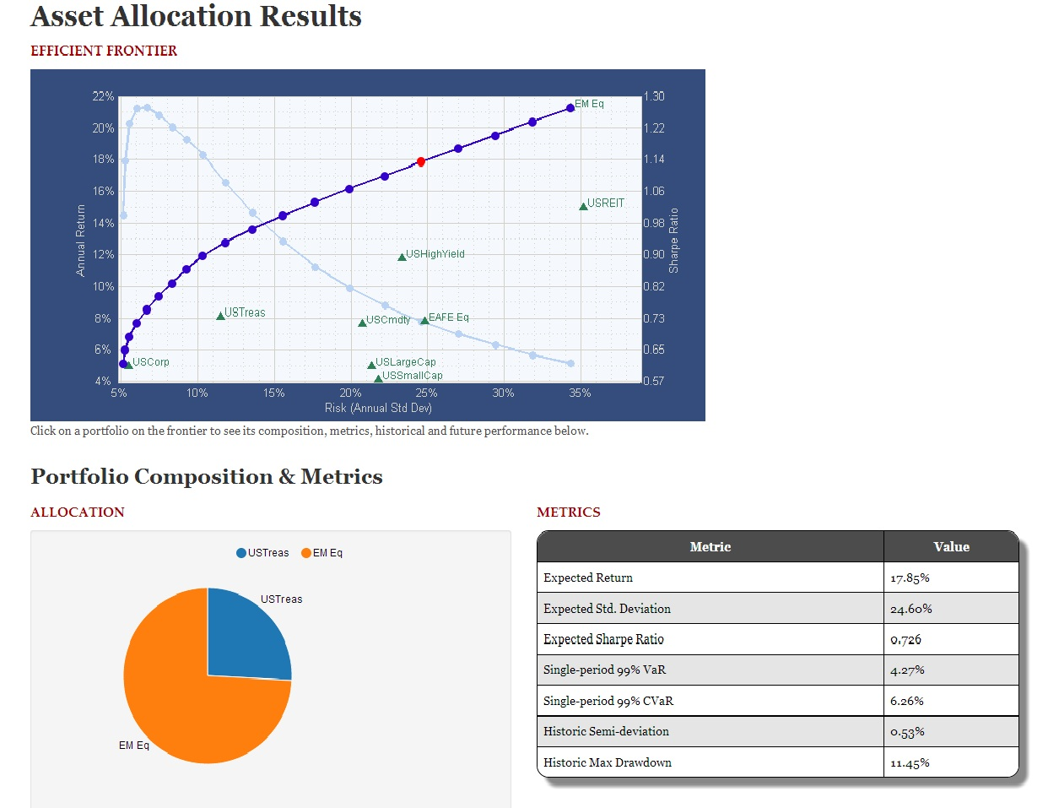
Demo : Portfolio Optimisation Web Application

Slide 5





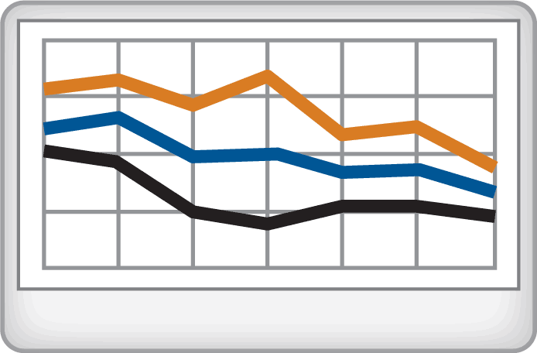

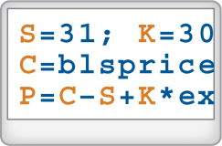
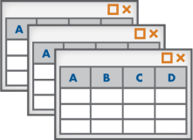
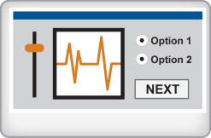
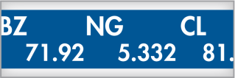

Computational Finance Workflow
Access
Research and Quantify
Share
Files
Reporting
Data Analysis & Visualization
Databases
Financial Modeling
Applications
Application Development
Datafeeds
Production
Automate

Slide 6
Agenda
Overview of the MATLAB Solution
Portfolio Analysis
Data import
Visualizing data
Customised portfolio analytics
Mean-Variance Portfolio Optimisation
CVaR Portfolio Optimisation
Reporting
Backtesting a portfolio management strategy
Key Takeaways

Slide 7
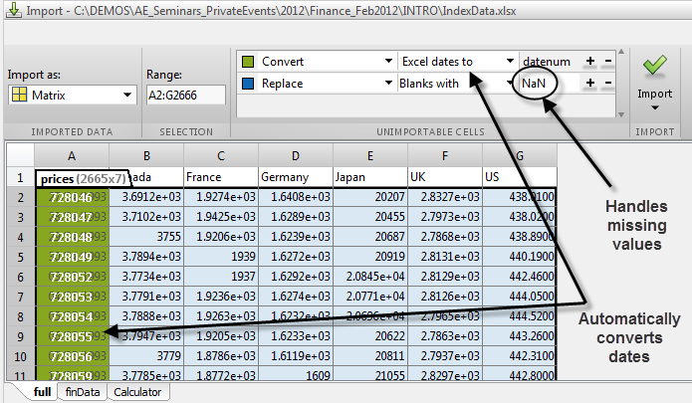
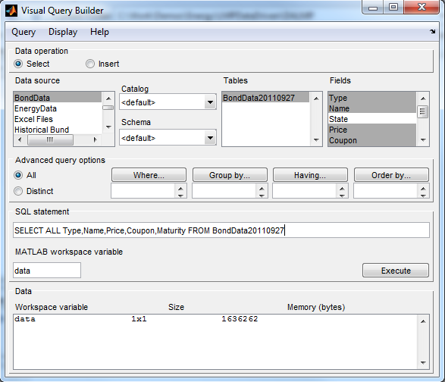
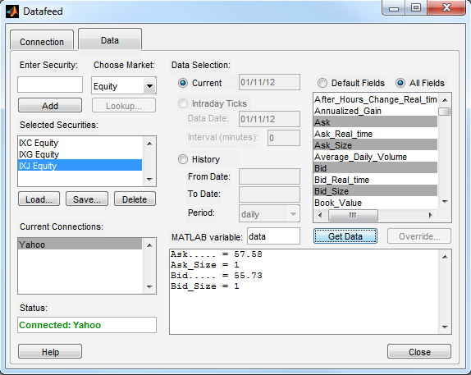
Import Data from Various Sources
Excel spreadsheets and flat files
ODBC or JDBC compliant databases
Data feeds including Bloomberg, Reuters, Factset®, eSignal® and others
Web services (SOAP)
Point & Click wizards to seamlessly import data
MATLAB code generation to automate your process

Slide 8
Agenda
Overview of the MATLAB Solution
Portfolio Analysis
Data import
Visualizing data
Customised portfolio analytics
Reporting
Backtesting a portfolio management strategy
Key Takeaways

Slide 9
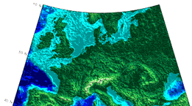



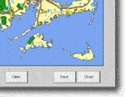
Visualization in MATLAB
Access
Explore & Discover
Share
Wide range of built in graphics functions (2D, 3D)
Interactive tools to annotate and easily customise plots
MATLAB code generation to automate your processes
Notes:
Once you have data in MATLAB you can analyze and visualize it in many ways.
For Data Analysis
You can manipulate, preprocess, and manage your data. For example by calculating statistics to understand its distribution or by using curve fitting to extract an underlying process.
You use fast, accurate pre-built math and engineering functions to carry out these tasks
Data visualization tools include
Built in 2D and 3D plotting and charting functions letting you quickly understand you data, such as the relation between results, variables and parameters in simulation for example.
There are interactive tools for data analysis also, where you can try ideas, changing algorithms then re-calculating to quickly iterate to an solution.

Slide 10
Agenda
Overview of the MATLAB Solution
Portfolio Analysis
Data import
Visualizing data
Customised portfolio analytics
Reporting
Backtesting a portfolio management strategy
Key Takeaways

Slide 11
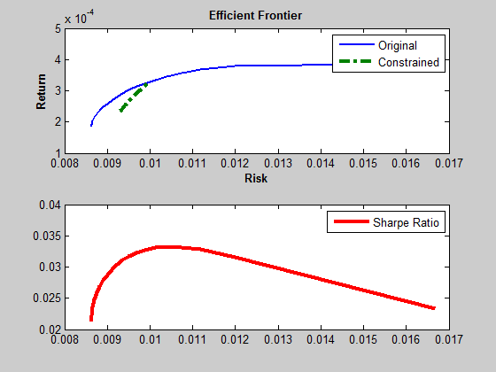
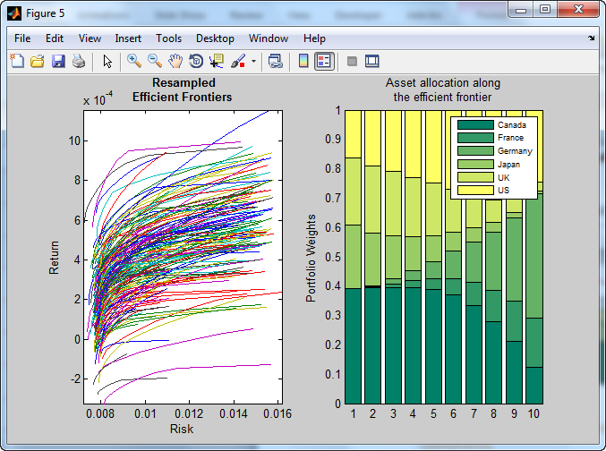
Portfolio Analytics
Powerful development environment
Highly documented examples
Very few lines of code required
>> p = Portfolio;
>> p = estimateAssetMoments(p,returns);
>> p = setCosts(p,BuyCost, SellCost);
>> p = setTurnover(p,TurnOver);
>> wts = estimateFrontier(p);
Portfolio object is customisable
can now include transaction costs, turnover & budget constraints

Slide 12
Mean-variance: Standard deviation of Returns
Notes:
Risk proxy is the variance of the portfolio, but often it is replaced with the standard deviation (the square root of the variance) – refer to Markowitz model.

Slide 13
CVaR – Expected Shortfall (new in R2012b)
Notes:
Conditional value at risk (CVaR) looks at the losses in the tail end of the distribution of scenarios. Say we chose a portfolio and calculate the losses for several different scenarios. The distribution of the asset returns may look something like this plot, where scenarios with the highest loss are on the right.
Value-at-risk, VaR_alpha(x), for portfolio x is the portfolio return such that the probability of portfolio returns failing below this level is (1-alpha).
Given VaR_alpha(x), for a portfolio x, the conditional value-at-risk of the portfolio is the expected loss of portfolio returns, above the value-at-risk return.

Slide 14
CVaR vs Mean-Variance
Sometimes, MV efficient frontier has lower-risk and lower-return portfolios than CVaR
When risk is matched, CVaR and Mean-Variance are similar
The more non-normal the distribution of returns is, the better the CVaR vs the mean-variance.
Notes:
CVaR tends to do a better job when you have a more non-normally distributed returns. At lower end of the efficient frontier you are trying to minimize the risk no matter what the return might be. The mean-variance is just trying to minimize this risk (these are symmetric risks) and because we have non-normal returns, it is introducing some bad correlation.

Slide 15
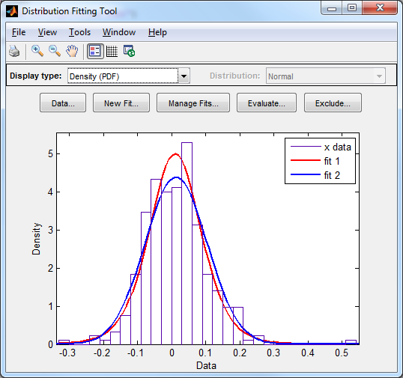
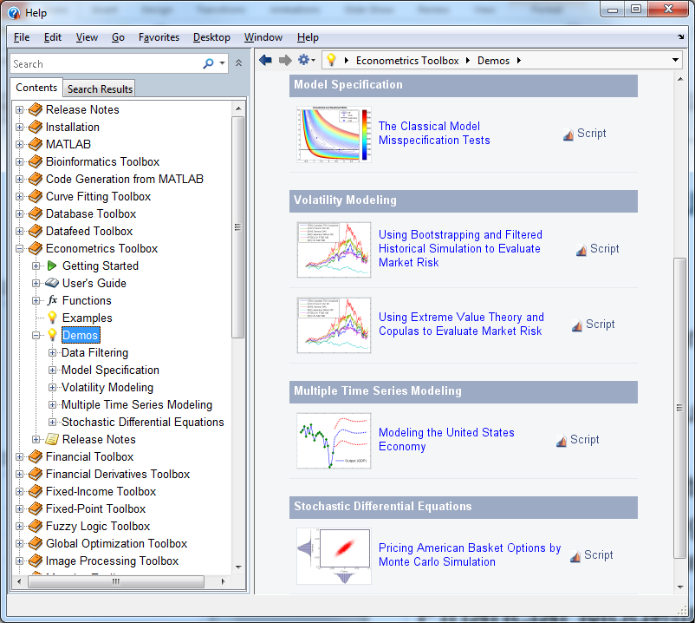
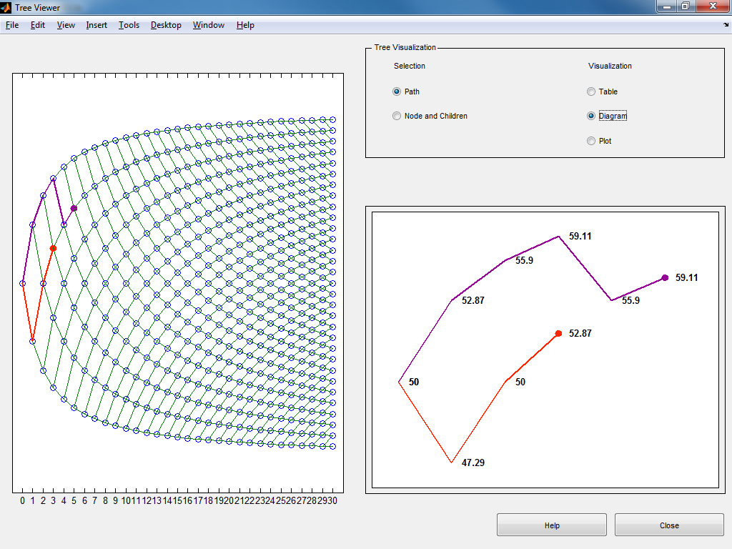
Leverage Built-in Functions to Save Time
Mathematics
Regression (Linear, Non-Linear)
Curve Fitting
Probability Distributions, RNG
Clustering
Multivariate & Factor Analysis
Predictive Modeling, Neural Nets
Optimization, Parameter Estimation
Financial Modeling
Portfolio Optimization & Analysis
Derivative Pricing & Hedging
Yield Curve Modeling
Monte Carlo Simulation
Risk Quantification
ARMA/GARCH Analysis

Slide 16
Agenda
Overview of the MATLAB Solution
Portfolio Analysis
Data import
Visualizing data
Customised portfolio analytics
Reporting
Backtesting a portfolio management strategy
Key Takeaways

Slide 17
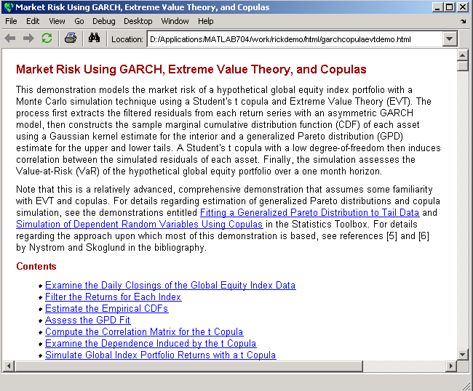
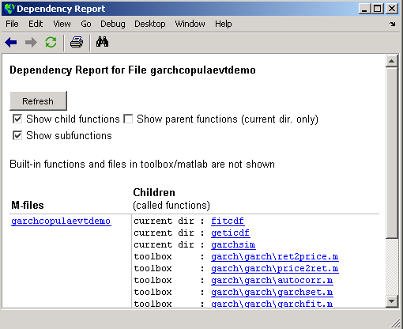
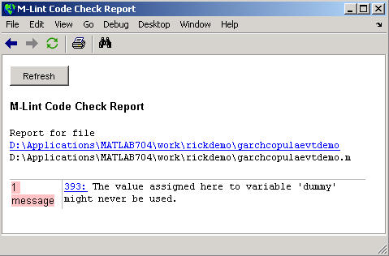
“Publish” to Create Self-Documented Code
Document your MATLAB scripts
Display code and comments
Include links, equations , graphics and markup
Share more than just code with colleagues
Include the results of your computations
Generate reports in multiple formats
HTML, PDF, XML, Word, LaTex, Powerpoint

Slide 18
A Range of Reporting Capabilities
 | Publishing | Report Generator | COM Interface
Effort required | Very Low | Moderate | High
Control over Formatting | Low | Moderate | High
Apply company styling standard | No | Yes | Yes
Embed variable in text | No | Yes | Yes
Platforms | All Supported | All Supported | Windows Only

Slide 19
Agenda
Overview of the MATLAB Solution
Portfolio Analysis
Data import
Visualizing data
Customised portfolio analytics
Reporting
Backtesting a portfolio management strategy
Key Takeaways

Slide 20
Key Takeaways
Access and import data from a range of financial data sources
Explore and visualise financial data quickly
Rapidly develop & customise financial models
Analyse, optimise & back-test portfolios
Incorporating transaction costs and turnover constraints
Handle missing data
Automated reporting
All the work is performed using one environment

Slide 21
Thank you! Additional Resources: Recorded Webinars: Using MATLAB to Optimize Portfolios with Financial Toolbox (for MATLAB code associated with the back-testing example illustrated in the GUI) Analyzing Investment Strategies with CVaR Portfolio Optimization in MATLAB Using MATLAB to Develop and Deploy Financial Models "The Prayer" - Ten-Step Checklist for Advanced Risk and Portfolio Management with Attilio Meucci Optimization Toolbox Demos: Large scale solver for quadratic programming problems http://www.mathworks.co.uk/products/optimization/demos.html

